Slide 1
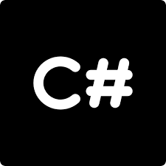
Introduction to

Slide 2
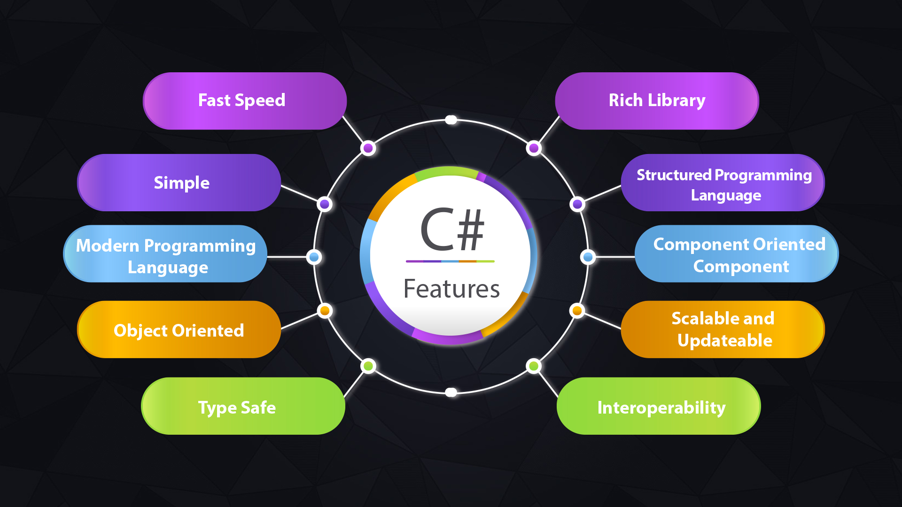

Slide 3
Class
A Class is like an object constructor, or a "blueprint" for creating objects.
it is a container for data and methods
C# is a block-structured language (code blocks are always enclosed by braces { and }).
eg:
using System;
namespace HelloCS
{
class Program
{
static void Main(string[] args)
{
Console.WriteLine("Hello World !!");
}
}
}

Slide 4
Main() Method
A method is a block of code which only runs when it is called.
“psvM()” defines a method named Main.
Every C# program must include the Main() method in one of the classes.
The starting point for the execution of the program.
Only one main method in a program and it is must to have one.
Key Notes :
public static void Main() - psvm()

Slide 5
public: Access modifier - Main method is accessible by anyone.
static: Main method is a global one and can be called without creating an instance of the class.
void: Main() doesn’t return any value
The WriteLine() - static method of the Console class, which is located in the namespace called System.
The ReadLine() - receive an input from the user while the program is executing.
eg:
static void Main()
{
double a,b; Console.WriteLine("Enter a Number");
a = double.Parse(Console.ReadLine());
Or
a = Convert.ToDouble(Console.ReadLine()); b = a * a;
Console.WriteLine(“The Square of ” + a + “ is ” + b);
}

Slide 6
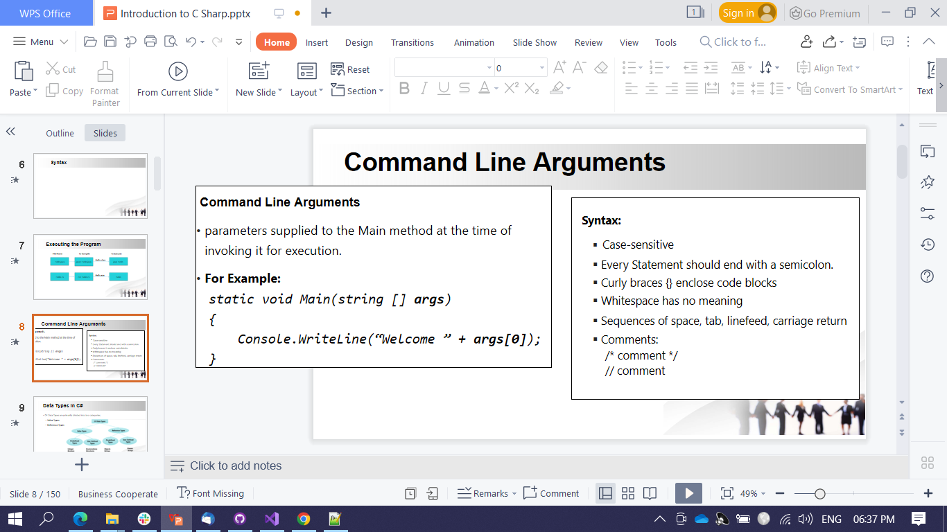
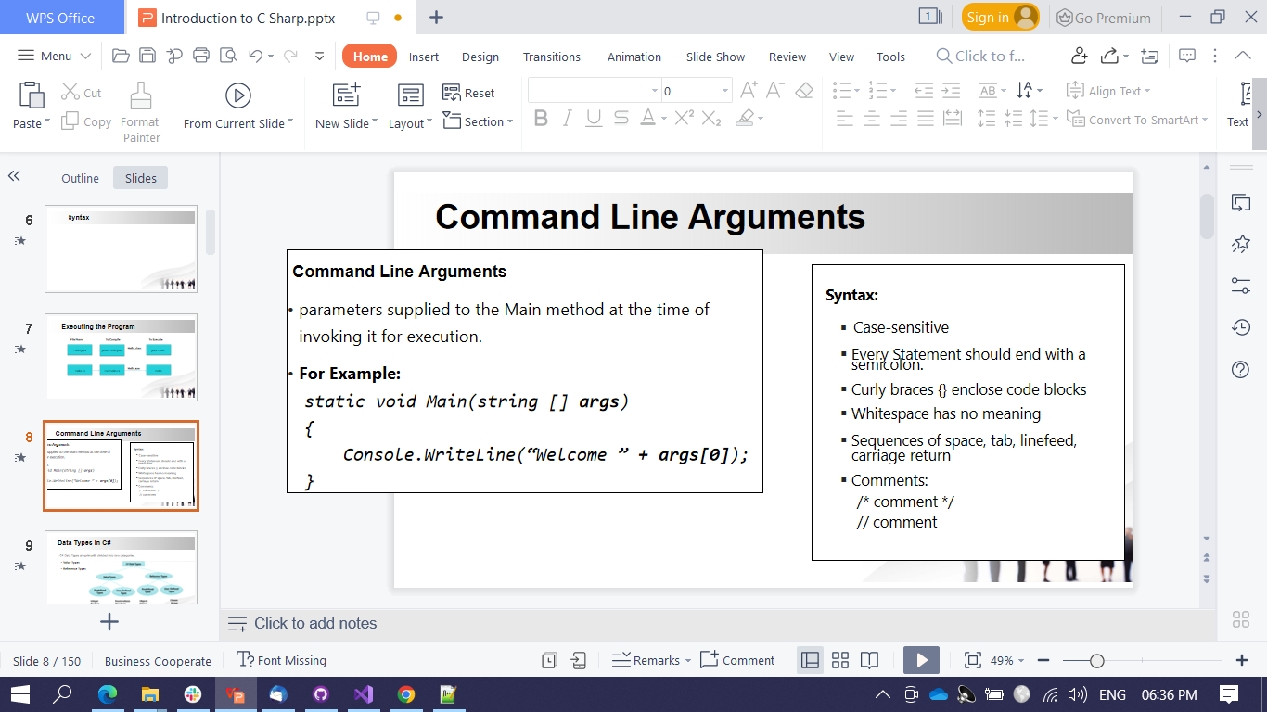

Slide 7
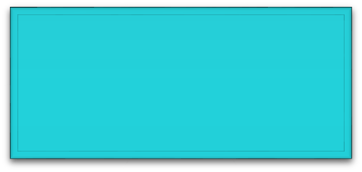
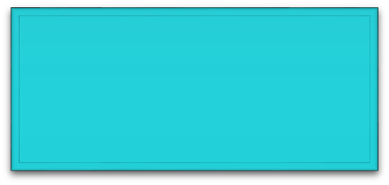
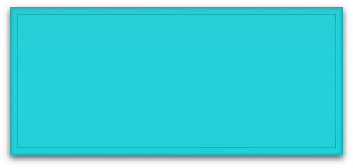
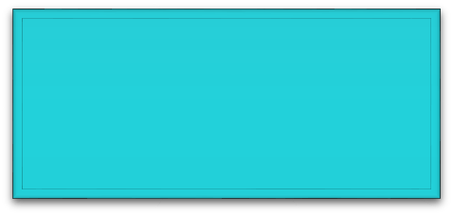
Executing the Program
File Name
To Compile
To Execute
Hello.class
Hello.java
javac Hello.java
java Hello
Hello.exe
Hello.cs
csc Hello.cs
Hello

Slide 8
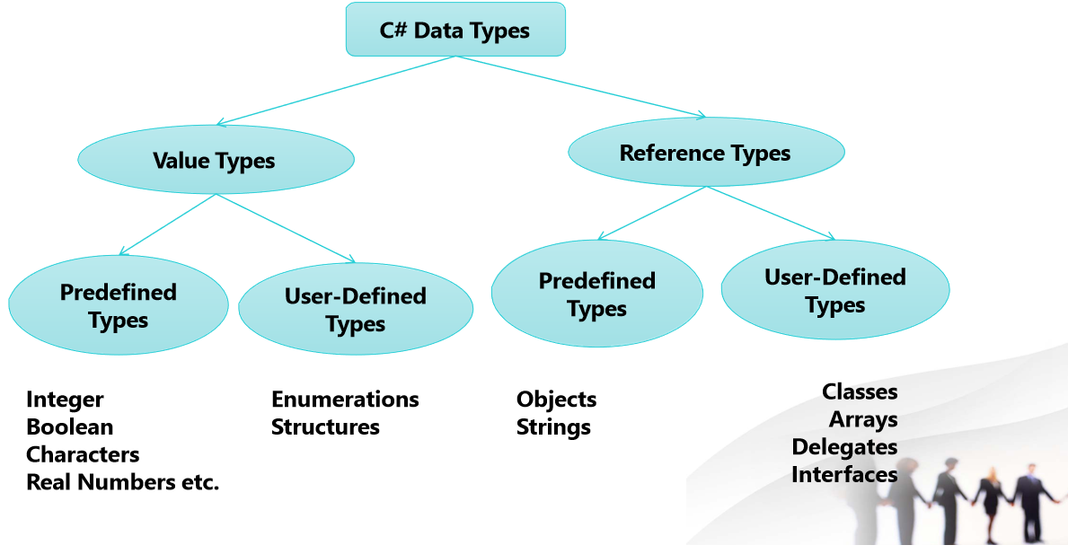
Data Types in C#
C# Data Types are primarily divided into two categories,
Value Types
Reference Types

Slide 9
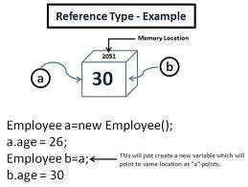
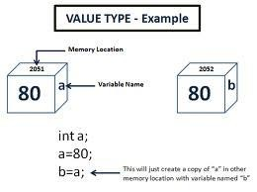
Example

Slide 10
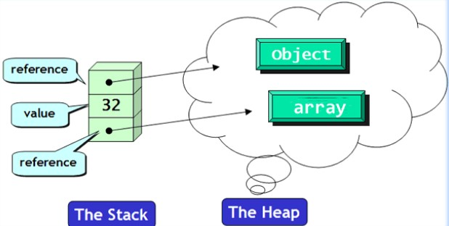
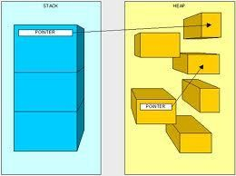
Stack and Heap

Slide 11
Declaration & Initialization of Variables
Declaration
A variable must be declared before it is used.
Syntax : type var1,var2,…………..var n;
Initialization
A variable must be given a value after it has been declared.
The syntax may be of two types,
Type var1 = value;
or
Type var1;
var1 = value;

Slide 12
Default values
Type | Default Value
All Integer Types | 0
Char | ‘\x000’
Float | 0.0f
Double | 0.0d
Decimal | 0.0m
Bool | False
Enum | 0
All Reference types | null

Slide 13
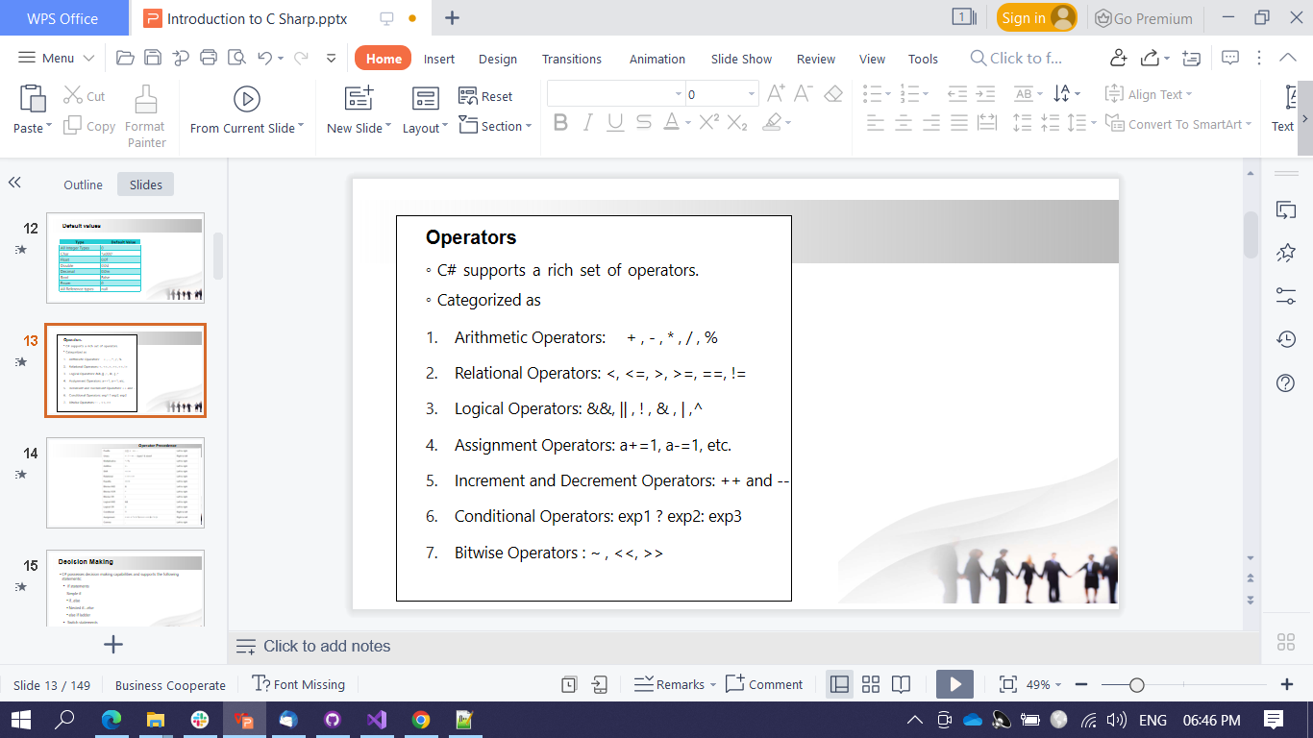
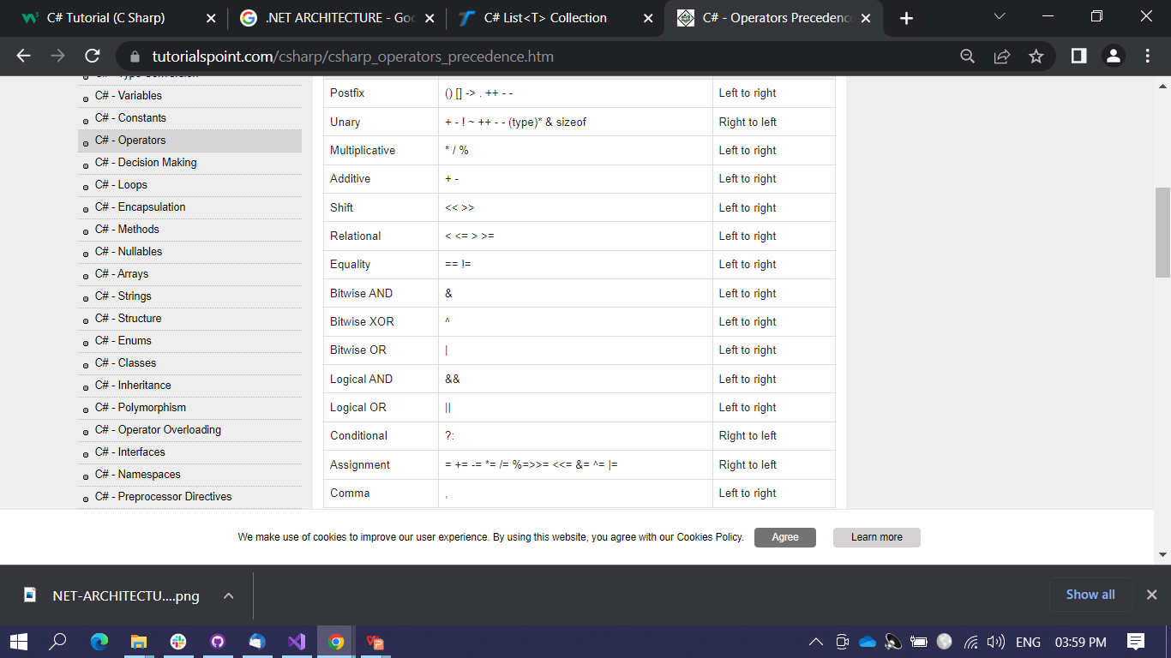
Operator & Precedence

Slide 14
Decision Making
Switch statement:
switch(expression)
{
case value-1:
code block-1
break;
case value-2:
code block-2
break;
default:
default-block
break;
}
Conditional statement :
variable = (condition) ? expressionTrue : expressionFalse;

Slide 15
If statements
Simple if
if(condition)
{
block //if yes, executes
}
if.. else
if(condition)
{
block-1 //if yes executes
}
else
{
block-2 //if no execures
}
else if ladder
if(condition)
{
block-1
}
else if(condition)
{
block-2
}
else
{
block-3;
}
Nested if... else
if(condition)
{
if(condition)
{......}
else
{......}
}

Slide 16
Looping Statements
C# provides four constructs for performing loop operations.
The while statement
The do…while statement
The for statement
The foreach statement.
While
initialization should be done before the loop starts
increment or decrement steps should be inside the loop.
Syntax:
While(condition) //while keyword
{
//code block executes until condition returns false
}

Slide 17
do while for
Executes atleast once even condition is false
Syntax:
do //do keyword
{
//code block
} while(condition);
Defines the condition for executing the code block.
Syntax:
for (initializer; condition; iterator)//for keyword
{
//code block executes until return false
}

Slide 18
For each statement
This is a special type of for loop which enables us to iterate through the elements in arrays and collection classes such as list and hash tables.
Syntax:
foreach ( type variable in collection) //foreach keyword
{
//body of the loop
}
Example:
int[] myArray = {1,2,3,4,5};
foreach(int m in myArray)
{
Console.WriteLine(m);
}

